Slide 1
HAC

Slide 2
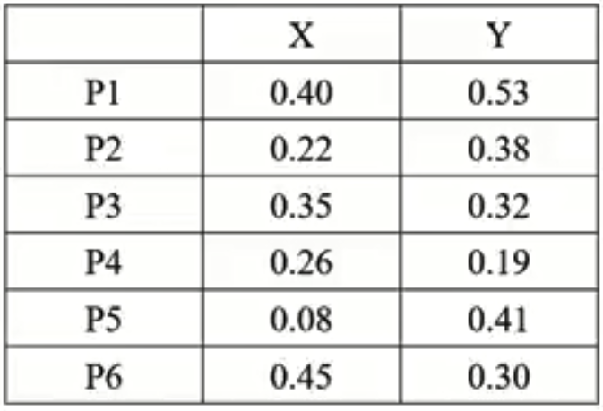
Sample Considered

Slide 3
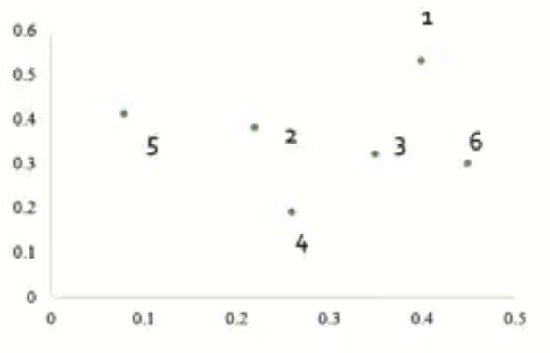
Table related Graph

Slide 4
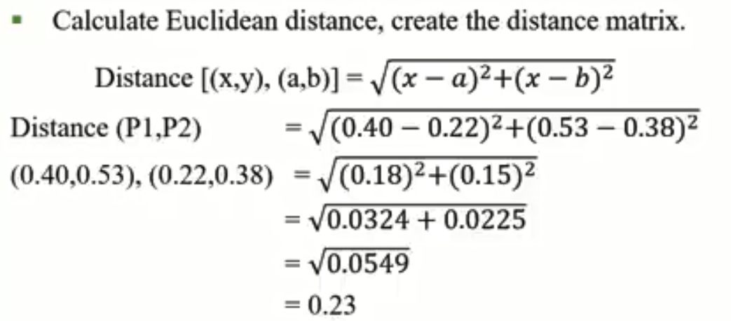
Euclidean Distance

Slide 5
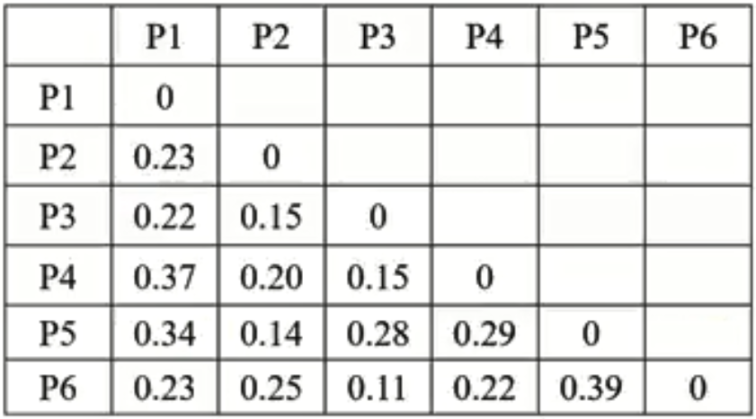
Distance Matrix

Slide 6
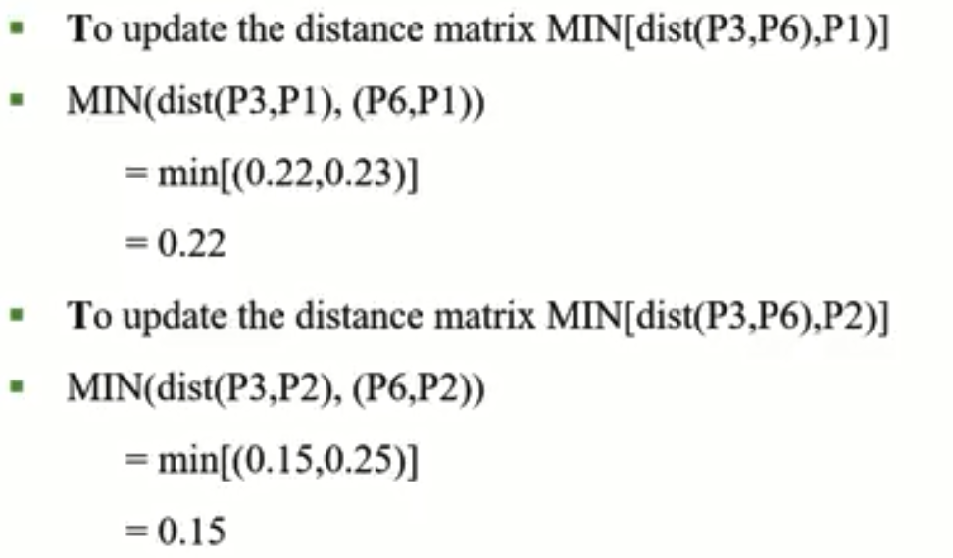
Update Distance Matrix

Slide 7

Example of Complete Link Calculation

Slide 8
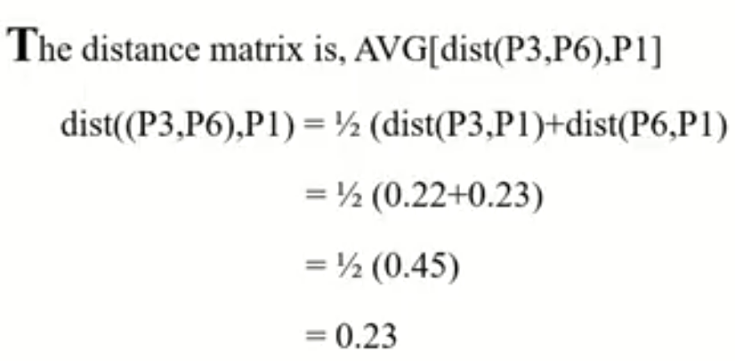
Example of Average Link Calculation

Slide 9
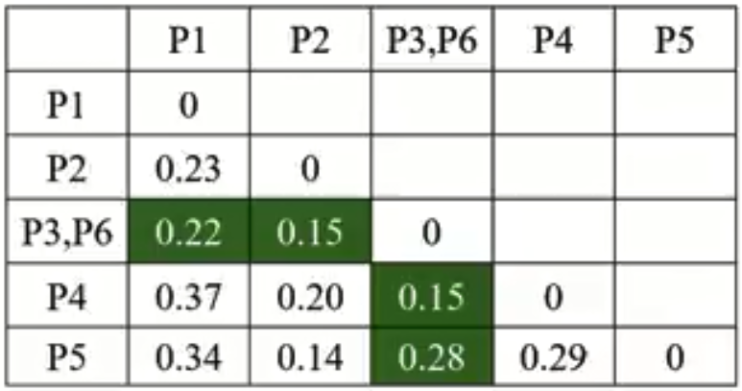

Slide 10
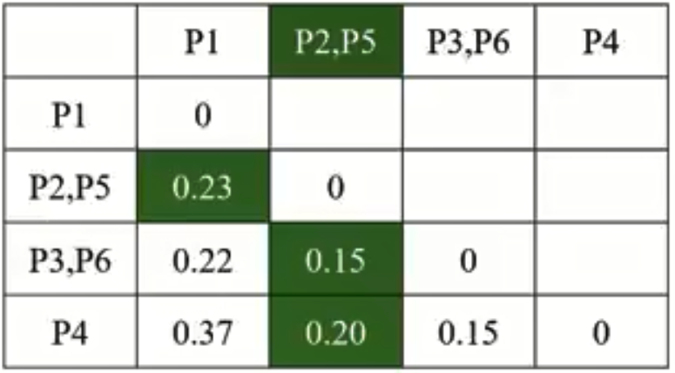

Slide 11
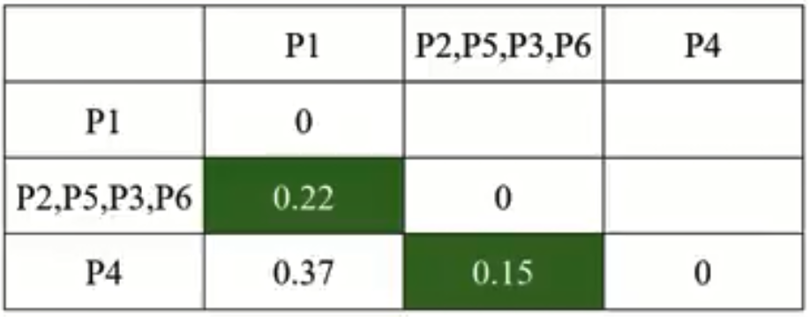

Slide 12


Slide 13
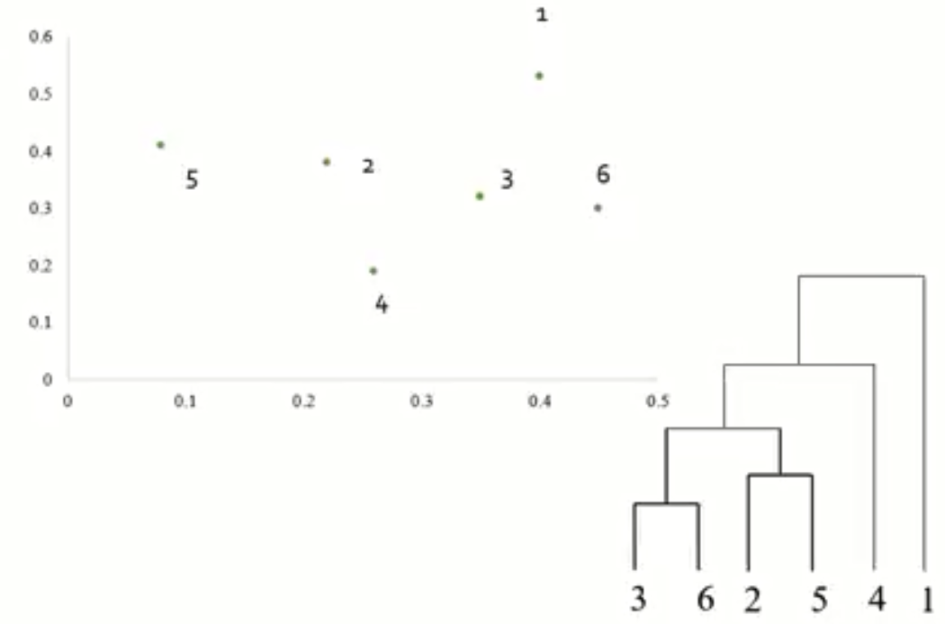
Final Dendrogram

Slide 14
The End

